Slide 1
CTODS Lab Viewer
Lab Viewer Grid Services
  Accepts study creation and patient enroll messages from C3PR to store in CTODS
  Accepts HL7v3 CT Lab Messages from the Cancer Center Hub Client to store in CTODS
Lab Viewer Web Application
  Allows authorized users to view laboratory data that has been sent to the hub and saved in the CTODS database
  Out-of-range lab values are highlighted
    Future release will allow labs to be sent to caAERS as potential adverse events
  Any lab value can be selected and sent to C3D via the hub
  Provides hotlinks to caAERS and C3D

Slide 2
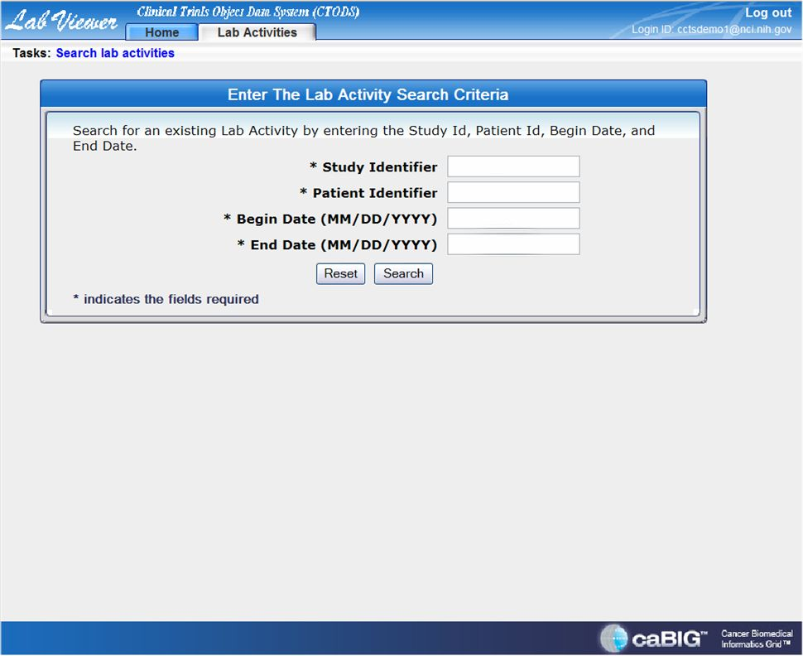

Slide 3
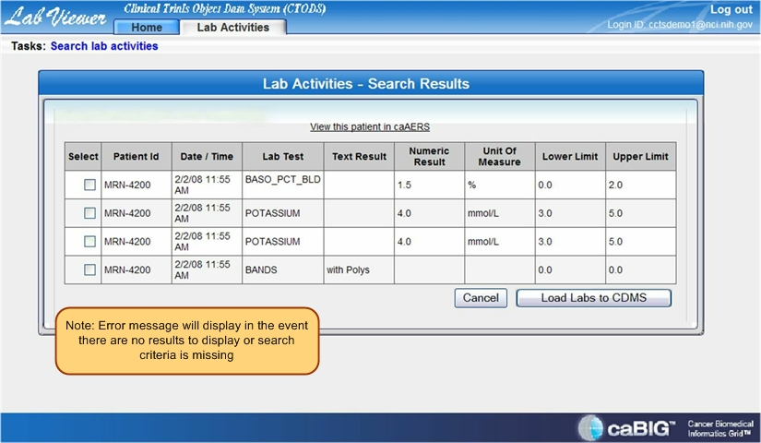

Slide 4
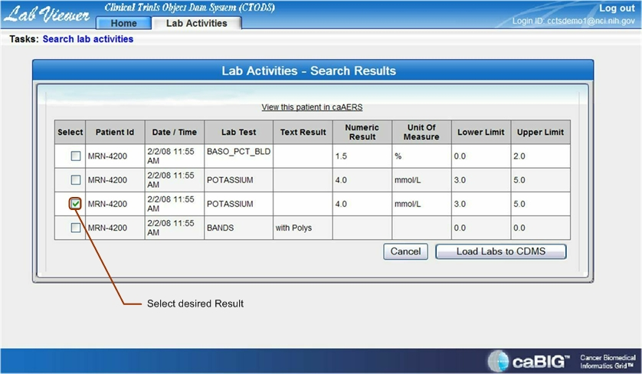

Slide 5
